Slide 1

Mini Project-I (K24MCA18P) Odd Semester Session 2024-25
Workplace – Dairy Farming(My Farm)
Aditya Chaudhary : 2426MCA638
Aaryan Gautam :2426MCA183
Akash Chaudhary :2426MCA197

Slide 2
Content
Introduction (1 slide)
Literature Review (2 slides)
Objective of the Project (1 slide)
Technology
Hardware Requirements (Development Environment, Server requirement (if required), Client requirement (if required).
Software Requirements
Modules (2 slides)
Workflow (1 slide)
Reports
References (1 slide)
Notes:
Font Styles: Times New Roman + Font Size: 25

Slide 3
Introduction
Overview : This project focuses on building a user-friendly platform dedicated to the online sale and delivery of dairy products like milk, cheese, butter, yogurt, and more.
The platform ensures direct connections between local dairy farmers, suppliers, and consumers, reducing reliance on intermediaries.
It combines technology with agriculture to improve supply chain efficiency, ensure product
freshness, and provide convenience to users.
Importance:
Rising demand for fresh dairy products in urban areas.
Growth in e-commerce adoption post-pandemic.
Notes:
Font Styles: Times New Roman + Font Size: 25

Slide 4
Literature Review
Existing Platforms and Their Features : BigBasket :
Offers dairy products as part of their groceries.
Lacks a dedicated focus on dairy products.
Limited in customization for dairy-specific logistics like cold storage.
Milkbasket :
Provides subscription-based delivery for daily essentials, including milk.
Limited geographic coverage and limited product variety.
Challenges in Current Platforms :
Lack of real-time stock visibility for consumers.
High delivery delays due to improper supply chain management.
Lack of farmer participation in the direct sale process.
Notes:
Font Styles: Times New Roman + Font Size: 25

Slide 5
Literature Review (Contd.)
Research Findings :
E-commerce in the dairy sector is expected to grow at a CAGR of 20% over the next five years.
AI-based systems and IoT have been shown to improve inventory tracking and delivery logistics in the food industry.
Consumer demand for eco-friendly packaging and direct-from-farm sourcing has increased.
Gap Identified :
No comprehensive platform exists that offers real-time updates, fresh product delivery, and direct farmer engagement under one system.
Notes:
Font Styles: Times New Roman + Font Size: 25

Slide 6
Objective of the Project
Primary Objective:
To create a robust e-commerce website dedicated to the sale and delivery of fresh dairy products.
Specific Goals :
Build a seamless user interface for consumers to browse and purchase products.
Integrate real-time stock updates to ensure availability.
Implement logistics tracking to minimize delivery delays.
Provide local dairy farmers with a platform to sell their products directly to consumers, ensuring better income and fair trade.
Optimize the supply chain using advanced technologies such as AI and IoT.
Notes:
Font Styles: Times New Roman + Font Size: 25

Slide 7
Technology (Hardware Requirements)
Requirements:
Development Environment :
A workstation with a high-speed processor (Intel i5 or higher), 16GB RAM, and 512GB SSD for development.
Reliable internet connection to host and test the website.
Server Requirements :
Cloud-based server (AWS/Google Cloud) with at least 8-core CPU, 32GB RAM, and 1TB storage for
hosting the application and managing databases.
Notes:
Font Styles: Times New Roman + Font Size: 25

Slide 8
Technology (Software Requirements)
Frontend :
React.js for building a responsive user interface.
CSS frameworks like Bootstrap for UI design.
Backend :
Python (Django Framework) or Java (Spring Boot) for server-side logic.
Database :
MySQL for structured data storage like product listings and orders.
MongoDB for storing unstructured data like logs and analytics.
Additional Tools :
Docker for deployment.
Payment Gateway APIs (e.g., Razorpay/Stripe).
Logistics integration (Google Maps API for delivery tracking).
Notes:
Font Styles: Times New Roman + Font Size: 25

Slide 9
Modules
Module 1: User Management
Features:
User registration and login.
Role-based access for customers, admins, and delivery agents.
Profile management, including delivery address and payment preferences.
Module 2: Product Catalogue
Features:
Categorization of products (e.g., milk, cheese, butter).
Advanced search and filtering options.
Real-time updates on product availability and pricing.
Notes:
Font Styles: Times New Roman + Font Size: 25

Slide 10
Modules (Contd.)
Module 3: Order Management
Features:
Add-to-cart functionality with support for multiple payment methods.
Order tracking with real-time status updates.
Alerts and notifications for order confirmation, dispatch, and delivery.
Module 4: Delivery and Logistics
Features:
Integration with delivery services for real-time tracking.
Scheduling for recurring orders (e.g., daily milk delivery).
Feedback system for delivery agents.
Notes:
Font Styles: Times New Roman + Font Size: 25

Slide 11
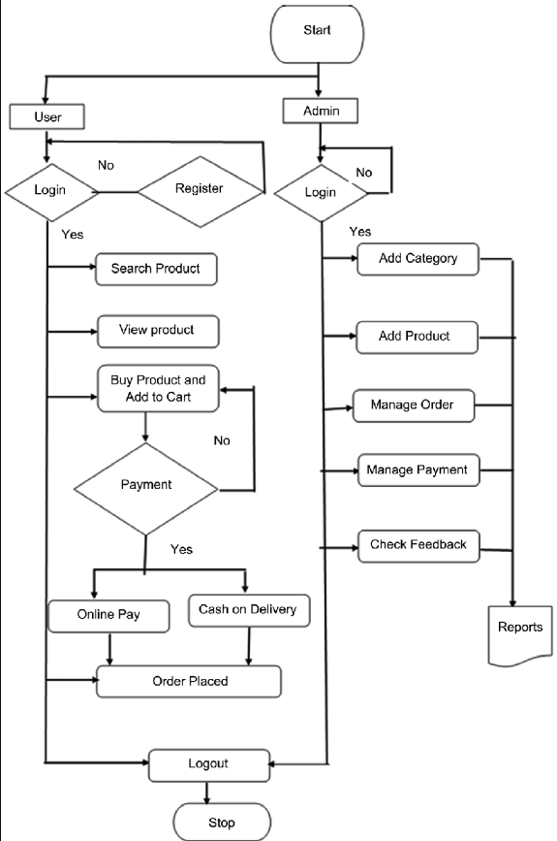
Workflow/Gantt Chart
Notes:
Font Styles: Times New Roman + Font Size: 25

Slide 12
Reports
Admin Reports :
Total sales and revenue breakdown.
Daily, weekly, and monthly inventory usage.
Customer activity and order trends.
User Reports :
Order history with detailed status and payment information.
Subscription details (if applicable).
Analytics on personal preferences and most-purchased products.
Notes:
Font Styles: Times New Roman + Font Size: 25

Slide 13
References
E-commerce Trends in Dairy Industry, Journal of Food Retailing, 2023.
BigBasket and Milkbasket websites: www.bigbasket.com and www.milkbasket.com.
Case Study: Impact of E-commerce on Agriculture Supply Chains, 2022.
Research Paper: Integration of AI in E-commerce Logistics, Tech Innovators, 2021.
Notes:
Font Styles: Times New Roman + Font Size: 25

